Slide 1
??
Internal Project
Web report
25 July 2016

Slide 2
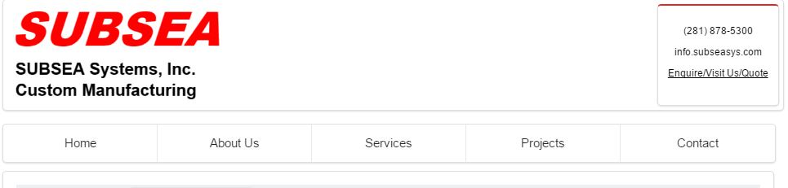
Comment-1
Excess white space is a waste. Use every pixel to our advantage. can we squeeze the menu between logo & content?

Slide 3
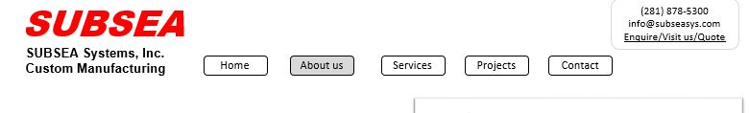
Comment-2
The menu should highlight the page the user is in. Use dark grey colour.
This can be achieved by using 3 Containers as the website header:
Left container: logo; Center container: Menu ; Right container:

Slide 4
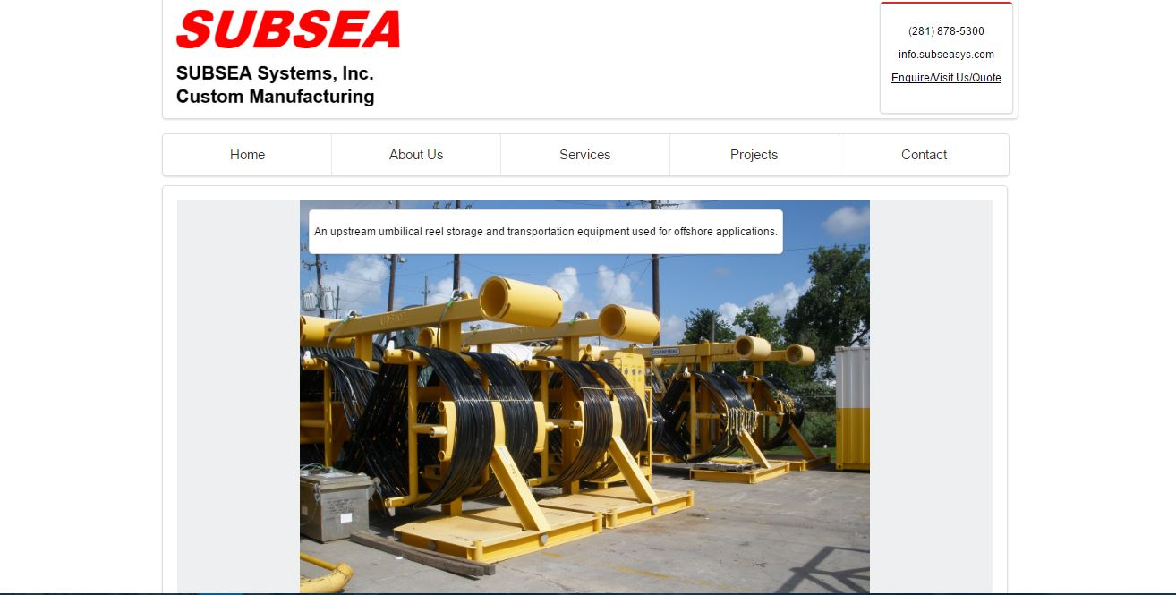
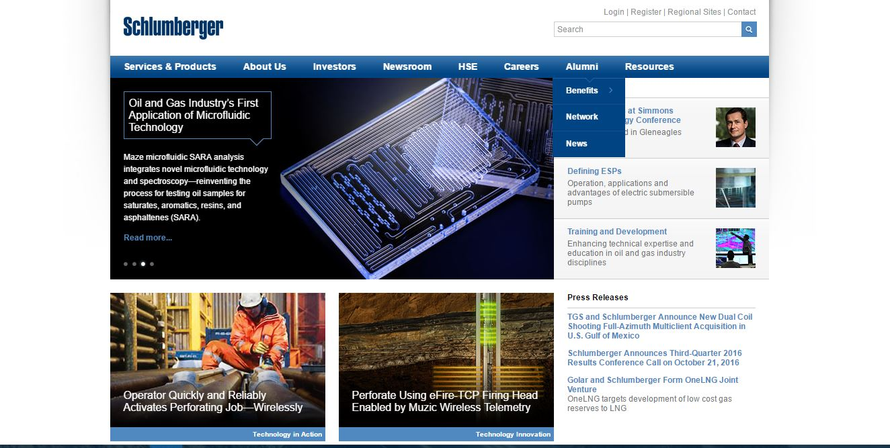
Comment-3
Separate the background screen like as shown in the Schlumberger site. www.slb.com

Slide 5
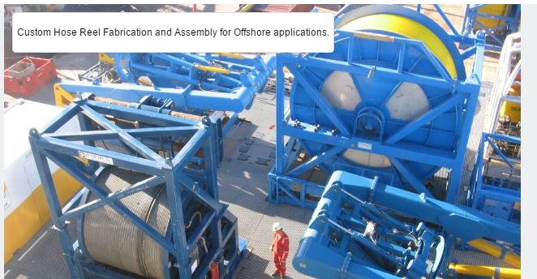

Comment-4
Keep the text as shown right side screen shot.
I suggest we should be able to position the Caption at 4 locations
left top or Left bottom or Right top/Right bottom. I want to use this text to hide sore objects (like bottle sprayer in a picture) etc. etc.

Slide 6
THANK YOU
For the opportunity to serve!

Slide 7
Document Revision History
01 | PRE-0001-01 Web report preview comments | 1 Sept 2016 |  | GSY | VA | ?
Rev | Description | Date |  | Author | Checked | Approved
Document No: |  |  | Client Ref:
PRE-0001-01 Web report preview comments |  |  | n/a

